Slide 1

Introduction
Lecture 0.2 | CSE421 – Computer Networks
Department of Computer Science and Engineering School of Data & Science

Slide 2
Objectives
Components of network
Data representation
Types of network

Slide 3
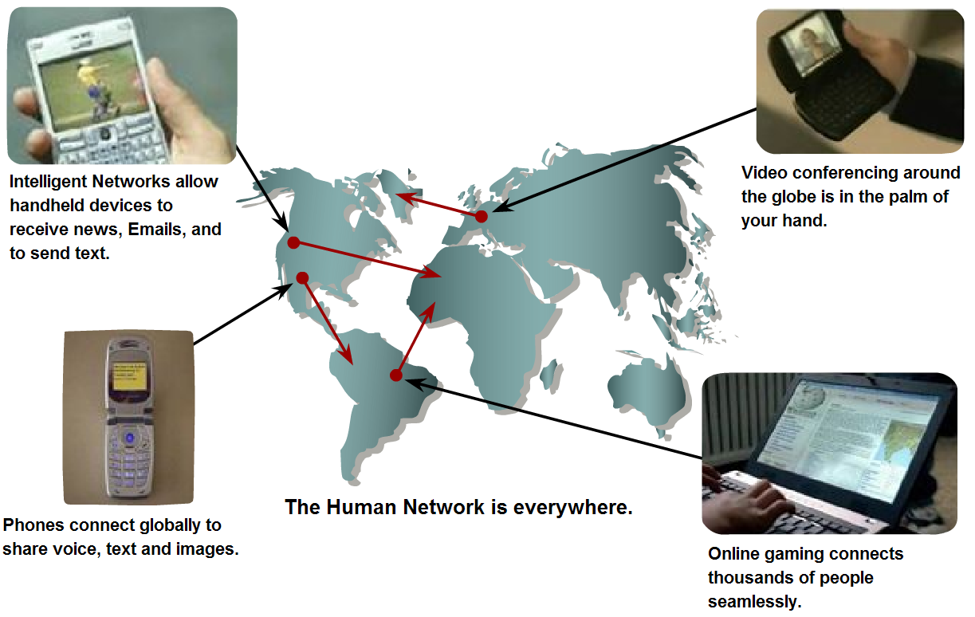
So, what’s the purpose of networks?
Communications!

Slide 4



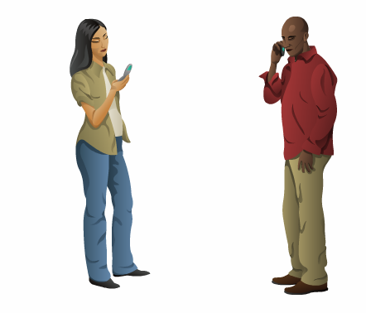
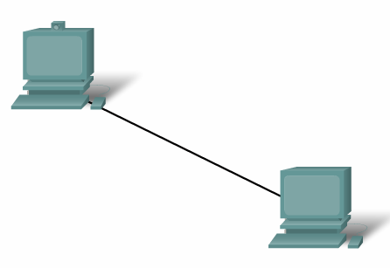

Elements of Communication

Slide 5
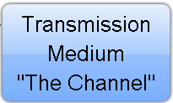




Elements of Communication - Example
What are the elements?

Slide 6
Elements of Communication
Devices (Sender/Receiver)
These are used to communicate with one another
Medium
This is how the devices are connected together
Messages
Information that travels over the medium
Rules
Governs how messages flow across network

Slide 7
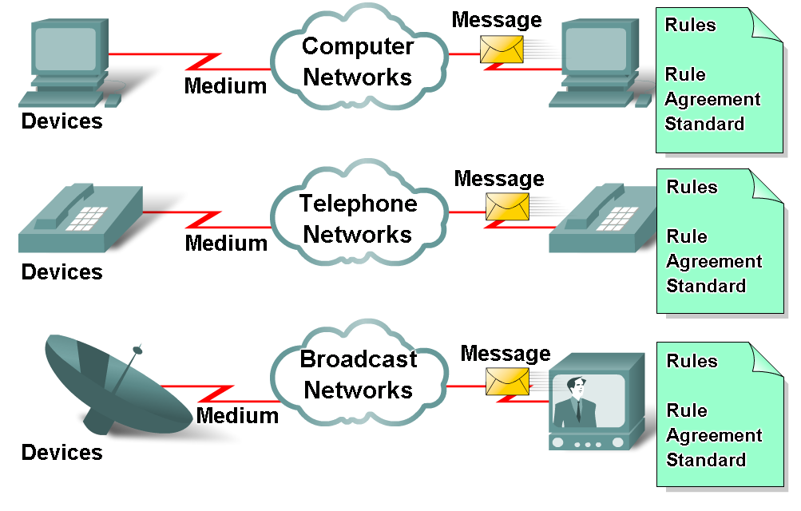
Elements of Communication

Slide 8
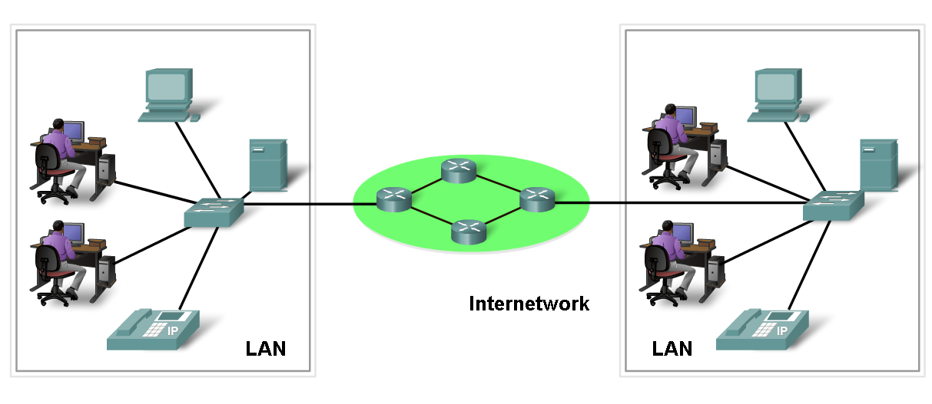
Network Elements/Components
Network Devices
Hardware (Devices)
Software (Services and Processes)

Slide 9
Network Component - Devices
Two types of devices:
End Devices:
Interface with human network & communications network
Data originates with an end device and arrives at an end device
Intermediary Devices:
Provides connectivity between end devices.
Manages data as it flows through the network

Slide 10





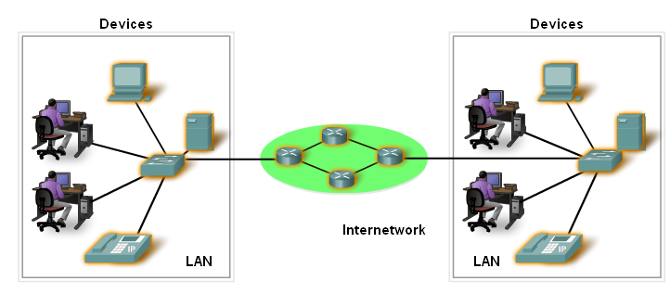
Network Component - Devices
End Devices | Intermediary Devices
Personal Computers Server | Router Switch

Slide 11
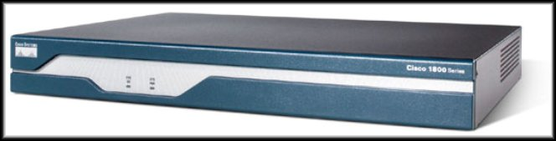
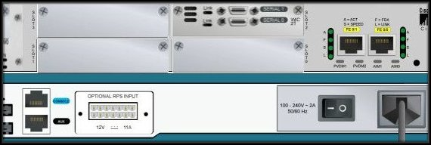
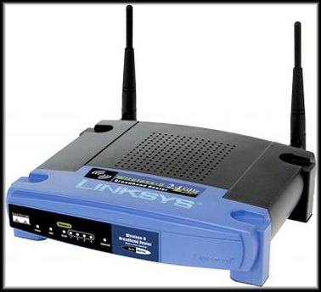
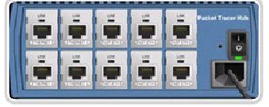

Network Component –Devices
Examples of Intermediary Devices
Router
Hub
Wireless Router
Switch

Slide 12

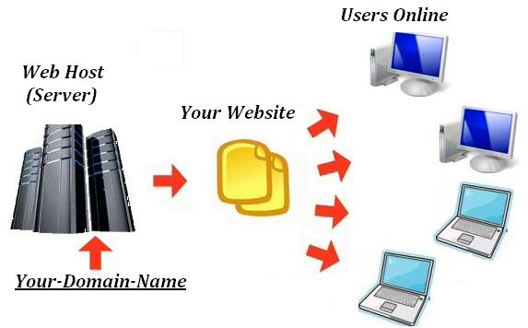
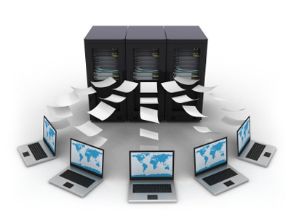
Software
Services :
Provides information in response to a request.
For example e-mail hosting services and web hosting services.

Slide 13
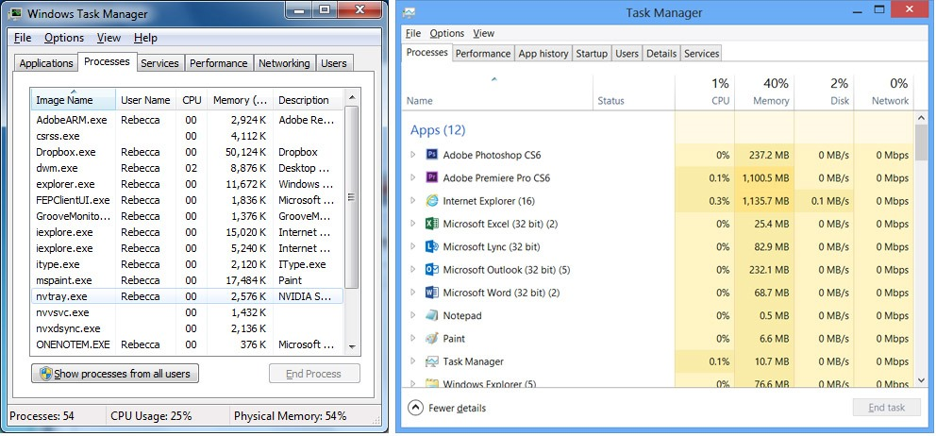
Software
Processes :
Provide the functionality that directs and moves the messages through the network.
Processes are less obvious to us but are critical to the operation of networks.

Slide 14
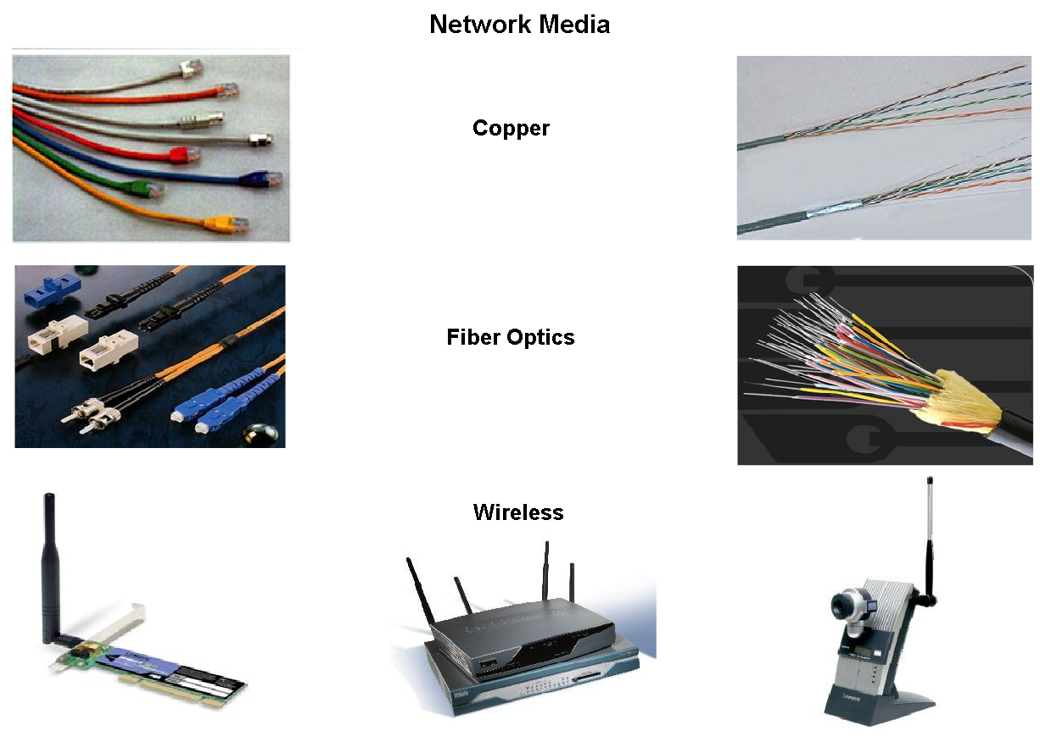
Media
The channel over which a message travels
Media Types | Description
Metal wires within cables | Uses electrical impulses
Glass or plastic fibers within cables (fiber-optic cable) | Uses pulses of light.
Wireless transmission | Uses modulation of specific frequencies of electromagnetic waves.

Slide 15
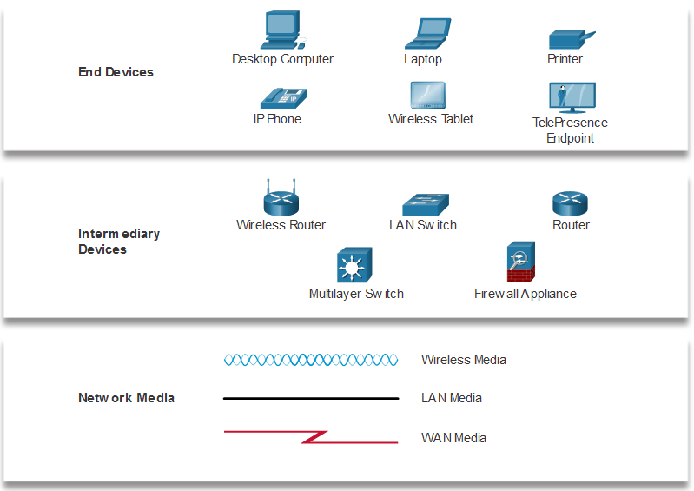
Network Representations
Network diagrams, often called topology diagrams, use symbols to represent devices within the network.
Important terms to know include:
Network Interface Card (NIC)
Physical Port
Interface
Note: Often, the terms port and interface are used interchangeably
Notes:
1 – Networking Today
1.3 – Network Representations and Topologies
1.3.1 – Network Representations

Slide 16
Message – Data Representation
Information today comes in different forms such as
text, numbers, images, audio, and video
Type of Data | Standards
Alphanumeric | ASCII, Unicode
Image | JPEG, GIF, PCX, PNG, TIFF, BMP, etc.
Motion picture/Video | MKV, AVI, MP4, MPEG-4, etc.
Sound | WAV, AU, MP3, etc.
Outline graphics/fonts | PDF, PS, AI, PostScript

Slide 17
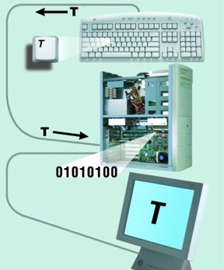
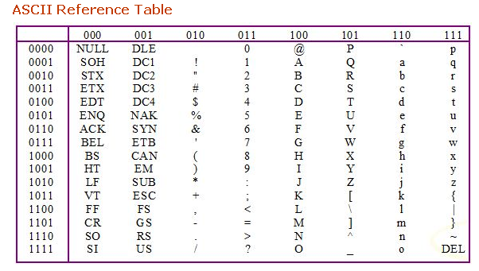
Data Representation - Text
Different sets of bit patterns are designed to represent text symbols. Each set is called a code.
ASCII
American Standard Code for Information Interchange: 7-bit code/char, 1 bit for parity.
Constitutes the first 127 characters in Unicode and known as basic Latin.

Slide 18
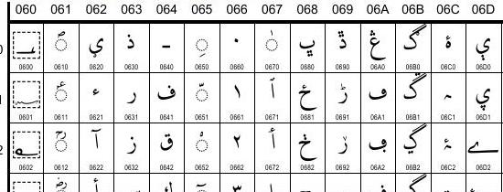
Data Representation - Text
Unicode:
16 bit codes to represent a symbol.
More characters can be represented.
But takes up twice the space.

Slide 19
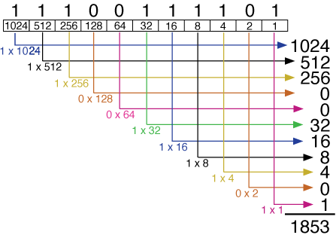
Data Representation - Numbers
Numbers :
Directly converted in to binary which is base 2.
The number 1853 in base 2 is really
Add!
All the numbers are in power of two!

Slide 20

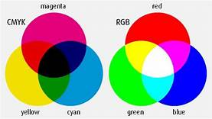
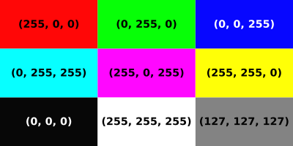
Data Representation - Images
Images
Also represented by bit patterns.
A digital image is made up of small units called pixels. Each pixel is assigned a bit pattern whose size depends on the nature of the image.
Color images uses RGB or YCM methods.
RGB

Slide 21
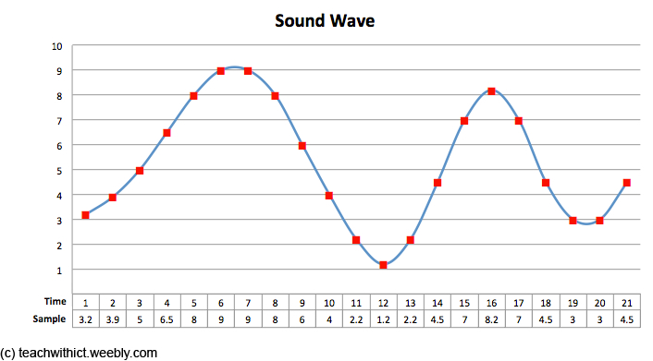
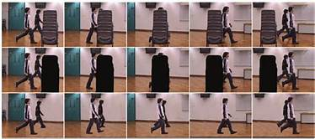
Data Representation – Audio & Video
Audio
Continuous, not discrete
Converted to digital or analog signal.
Video
Collection of frames(images) projected in sequence dynamically.
Each image is converted to a bit pattern and stored.

Slide 22
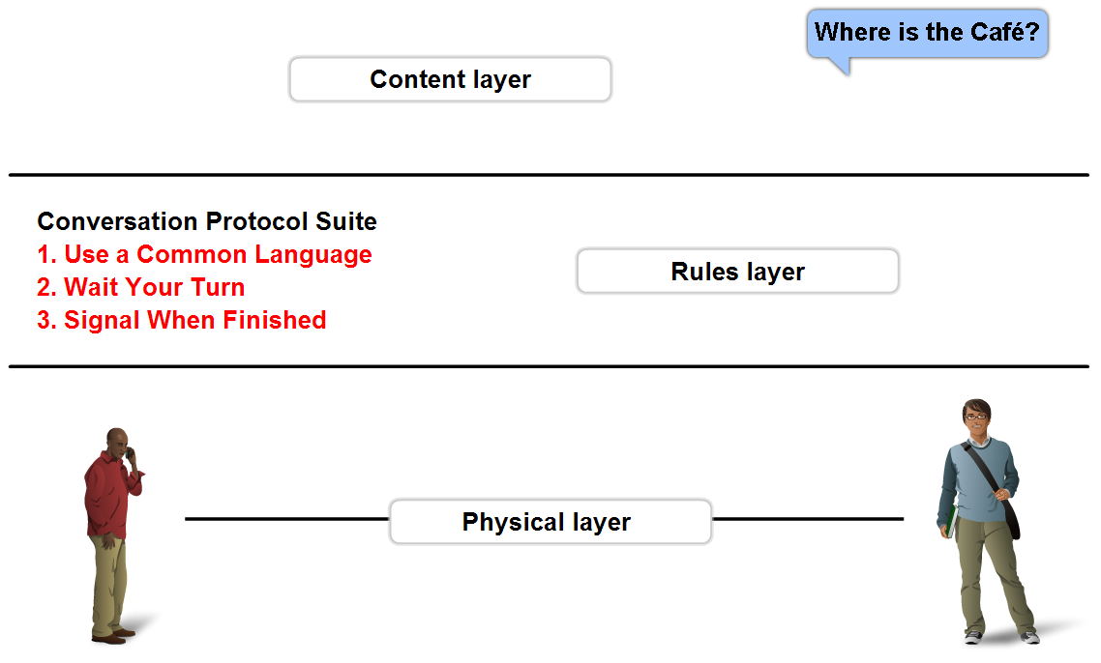
Rules - Protocols
A set of predetermined rules that govern communication.
Defines:
What is communicated??
How it is communicated??
When it is communicated??

Slide 23
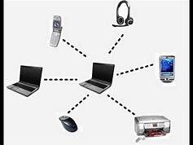
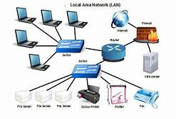
Types of Network
PAN – E.g. Bluetooth
A network that connects computers, peripherals and other devices within a personal operating space.
Typical coverage within 10 meters
LAN – E.g. Ethernet, Wireless LANs
Connects computers, peripherals and other devices within a building (e.g. office, home) or in a limited area.
Typical coverage 50 to 300 meters.

Slide 24
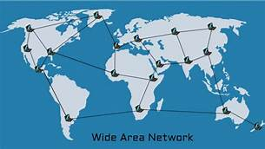
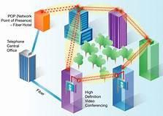
Types of Network
MAN – E.g. Wi-Max
Is a city wide network.
The coverage limitation is not strict, but real implementation may have range of up to 50 km in urban, suburban, or rural area.
WAN – E.g. PSTN, Cellular Networks (GSM etc)
A network that spans larger geographical area.
LANs separated by geographic distance are connected by a Wide Area Network (WAN).

Slide 25
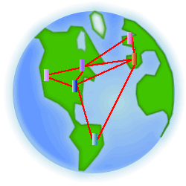
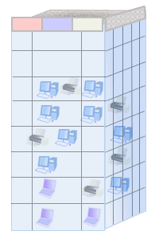

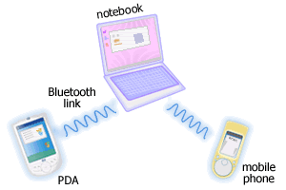
Types of Network – Can you identify?
WAN
LAN
MAN
PAN

Slide 26
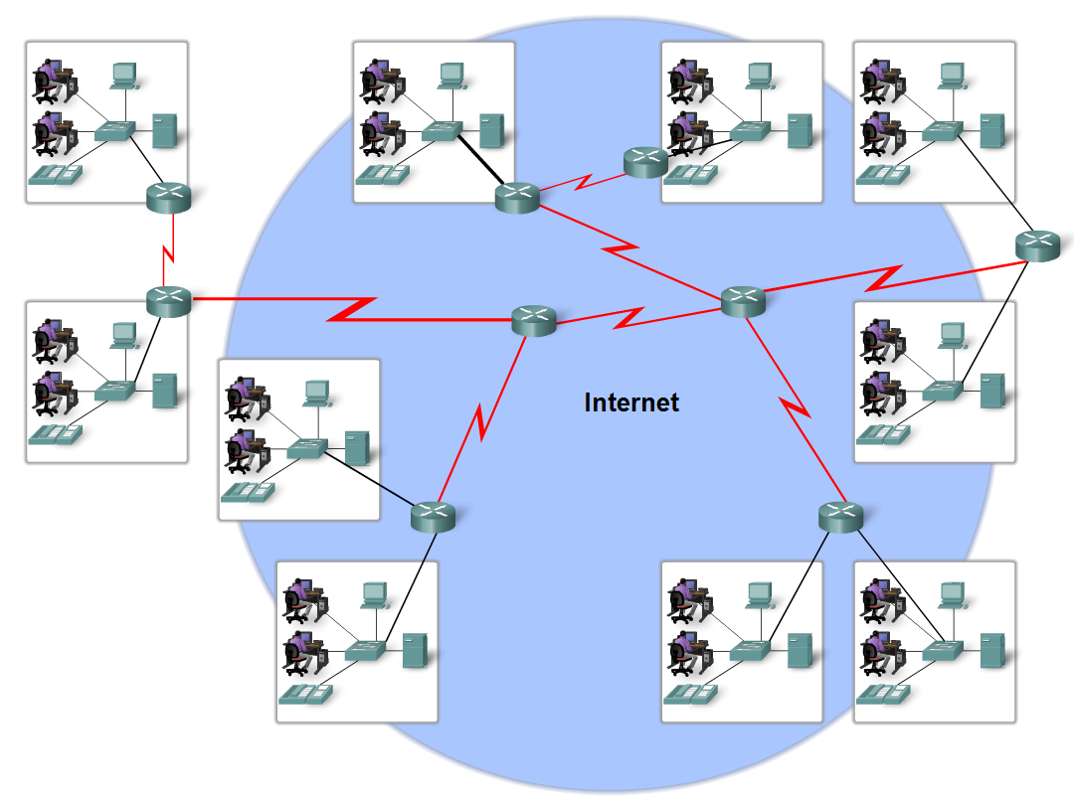
Internet
The Internet is defined as a global mesh of interconnected networks
What do you think Intranet is?

Slide 27
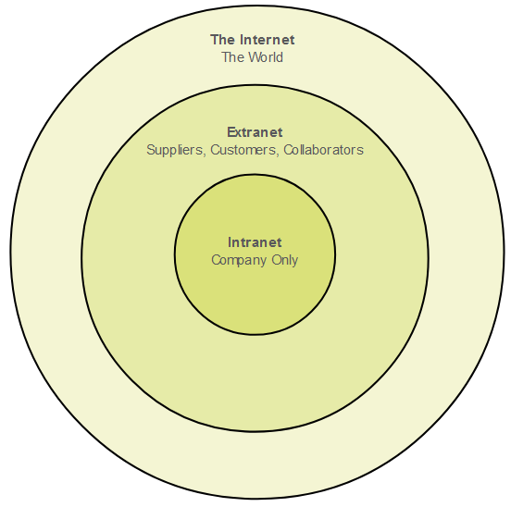
Intranets and Extranets
An intranet is a private collection of LANs and WANs internal to an organization
Extranet is used to provide secure access to their network for individuals who work for a different organization that need access to their data on their network.
Notes:
1 – Networking Today
1.4 – Common Types of Networks
1.4.4 – Intranets and Extranets
1.4.5 – Check Your Understanding – Common Types of Networks

Slide 28
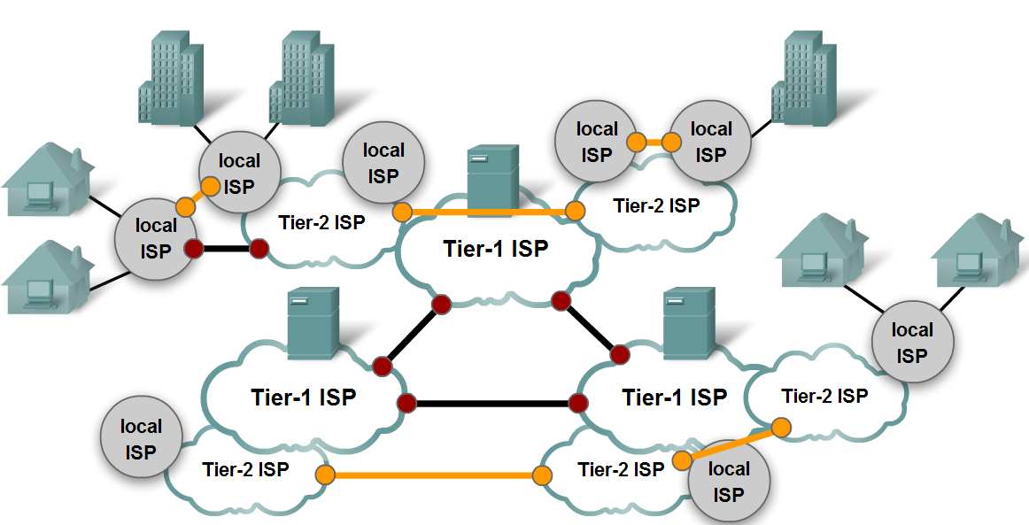
Internet (Continued)

Slide 29
For Queries be present in the live sessions. Or post your queries in the discussion board
Thank you

